Slide 1

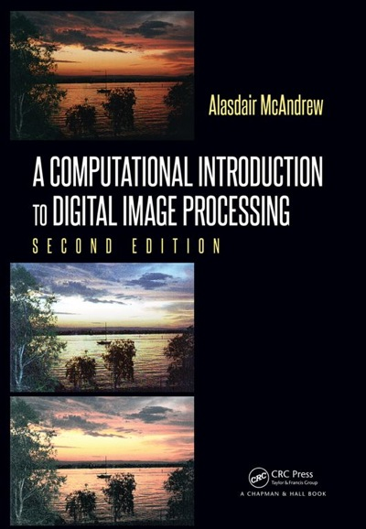
Chapter 5
Neighborhood Processing

Slide 2

Neighborhood Processing
Neighborhood processing: An extension of point processing, where a function is applied to a neighborhood of each pixel.
Mask: A rectangle (usually with sides of odd length) or other shape over the given image.
Filter: A combination of a mask and a function used to calculate new pixel values under the mask.
Why??

Slide 3
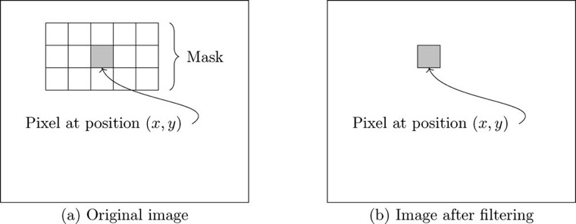
Neighborhood Processing

Slide 4
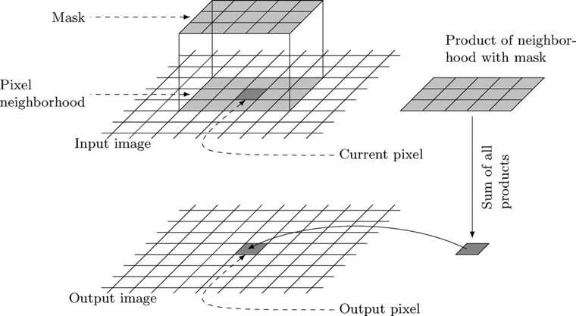
Linear Spatial Filtering
Linear Filter: A filter that uses a linear function to calculate new pixel values in the mask.

Slide 5
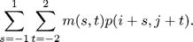
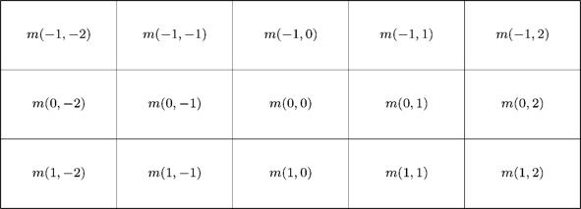
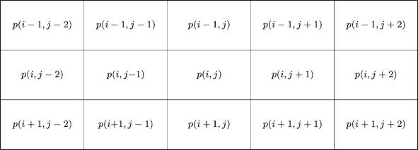
Linear Spatial Filtering
New pixel value at p(i,j) =
Mask Values:
Pixel Values:

Slide 6
Linear Spatial Filtering
New pixel value at p(i,j) =
In programming terms:
newp = 0;
for (s = -1; s <= 1; s ++)
for (t = -2; t <= 2; t++)
newp += m[s, t] * p[i + s][j + t];
newpic[i, j] = newp;

Slide 7
Linear Spatial Filtering
New pixel value at p(i,j) =
m
p
0 | 0 | 0
1 | 1 | 1
2 | 2 | 2
1 | 5 | 4 | 3 | 1 | 2
5 | 2 | 1 | 4 | 8 | 3
3 | 5 | 2 | 1 | 2 | 3
3 | 2 | 1 | 5 | 3 | 6
6 | 3 | 2 | 4 | 8 | 2
New pixel value for p(3,2)

Slide 8
Linear Spatial Filtering
New pixel value at p(i,j) =
m
p
0 | 0 | 0
1 | 1 | 1
2 | 2 | 2
1 | 5 | 4 | 3 | 1 | 2
5 | 2 | 1 | 4 | 8 | 3
3 | 5 | 2 | 1 | 2 | 3
3 | 2 | 1 | 5 | 3 | 6
6 | 3 | 2 | 4 | 8 | 2
New pixel value =
0 * 5 + 0 * 2 + 0 * 1 +
1 * 3 + 1 * 5 + 1 * 2 +
2 * 3 + 2 * 2 + 2 * 1 =
22

Slide 9
Linear Spatial Filtering
Linear Function:
Process (repeated for every pixel in the image):
1. Position the mask over the current pixel
2. Form all products of filter elements with the corresponding elements of the neighborhood
3. Add up all the products

Slide 10
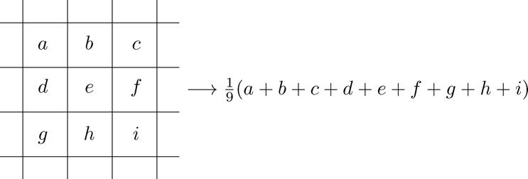
Linear Filtering Example
One important linear filter is to use a 3 × 3 mask and take the average of all nine values within the mask. This value becomes the gray value of the corresponding pixel in the new image. This operation may be described as follows:
e is the gray value of the current pixel in the original image, and the average is the gray value of the corresponding pixel in the new image.

Slide 11
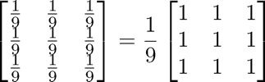
Linear Filtering Example
It is convenient to describe a linear filter simply in terms of the coefficients of all the gray values of pixels within the mask. This can be written as a matrix.
Averaging filter:

Slide 12
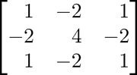
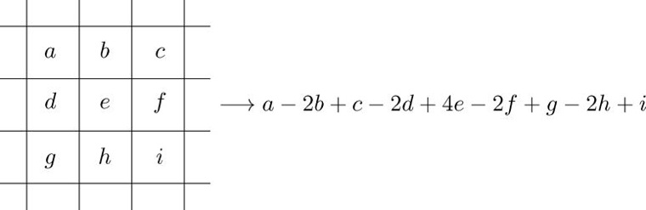
Linear Filtering Example 2

Slide 13
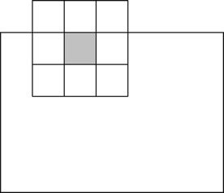
What about borders?

Slide 14
What about borders?
Ignore the edges
Mask is only applied to pixels for which the mask will lie fully within the image.
Output image that is smaller than the original.
May lose a significant amount of information.
“Pad” with zeros
Assume that all necessary values outside the image are zero.
Returns an output image of the same size as the original.
May have the effect of introducing unwanted artifacts (for example, dark borders) around the image.

Slide 15
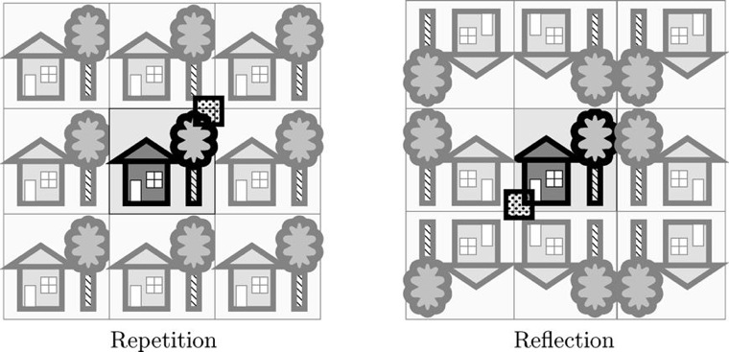
What about borders?
Repeat the image
Tile the image in all directions, so that the mask always lies over image values.
May introduce unwanted artifacts in the result.
Reflect the image
Similar to repeating, except that the image is reflected across all of its borders.
Ensures that there are no extra sudden changes are introduced at the borders.

Slide 16
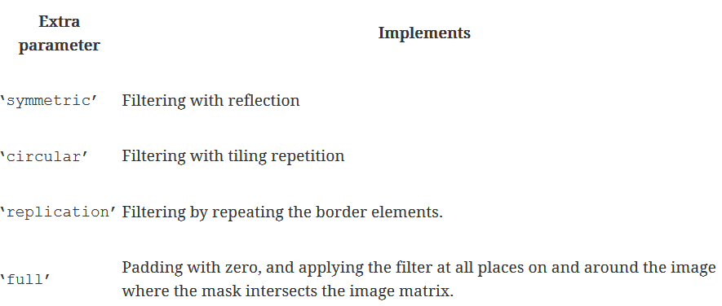
Linear Filtering MatLab/Octave
The last option returns a result that is larger than the original image.

Slide 17
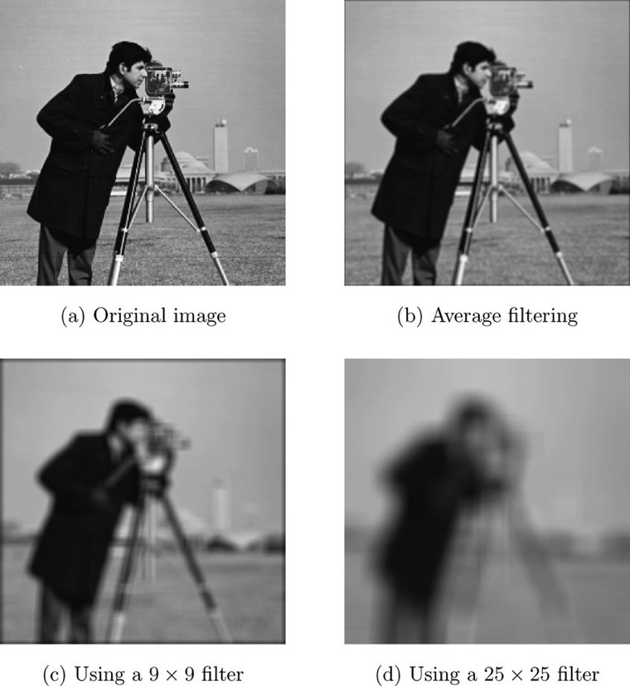
Average Filter
3 x 3 filter

Slide 18
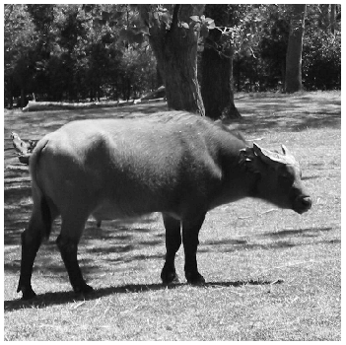
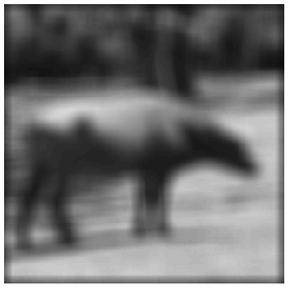
Octave Example
pic = imread('buffalo.png');
f1 = fspecial('average', 25);
newpic = imfilter(pic, f1);
imshow(newpic)
Pixels at the boundary of the image padded with zeros by default
pic
newpic

Slide 19

Octave Example
pic = imread('buffalo.png');
f1 = fspecial('average', 25);
newpic = imfilter(pic, f1, 'symmetric');
imshow(newpic)
Symmetric filters with reflection.
pic
newpic

Slide 20
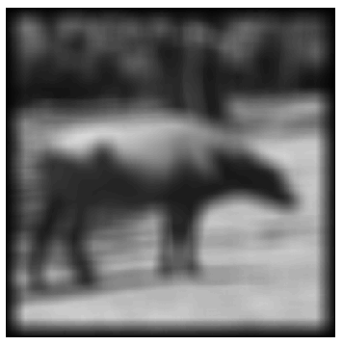
Octave Example
pic = imread('buffalo.png');
f1 = fspecial('average', 25);
newpic = imfilter(pic, f1, 'full');
imshow(newpic)
Full applies the filter at all places on and around the image where the mask intersects the image matrix - returns a result that is larger than the original.
pic
newpic

Slide 21
What is best?????
?????????
Ignore edges…
?????????
Pad with zeros…
Reflect…
?????????
?????????
Repeat…
?????????

Slide 22
What is best?????
Trick Question…
No single “best” approach; the method must be dictated by the problem at hand, by the filter being used, and by the result required.

Slide 23
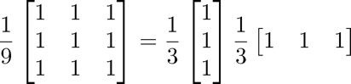
Separable Filters
Some filters can be implemented by the successive application of two simpler filters.
The 3 × 3 averaging filter can be implemented by first applying a 3 × 1 averaging filter, and then applying a 1 × 3 averaging filter to the result.
The application of an n x n filter requires n² multiplications, and n² − 1 additions for each pixel in the image. But the application of an n x 1 filter only requires n multiplications and n − 1 additions. Since this must be done twice, the total number of multiplications and additions are 2n and 2n − 2, respectively.

Slide 24
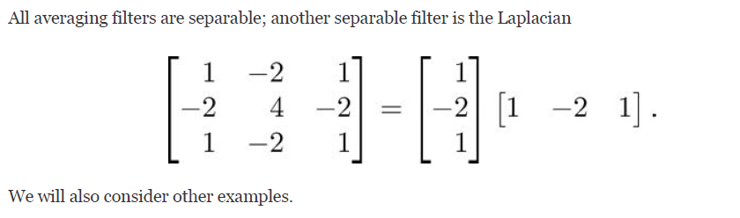
Separable Filters

Slide 25
Laplacian Filtering 3x3 mask
New pixel value at p(i,j) =
m
p
1 | -2 | 1
-2 | 4 | -2
1 | -2 | 1
1 | 5 | 4 | 3 | 1 | 2
5 | 2 | 1 | 4 | 8 | 3
3 | 5 | 2 | 1 | 2 | 3
3 | 2 | 1 | 5 | 3 | 6
6 | 3 | 2 | 4 | 8 | 2
New pixel value =
1 * 5 + -2 * 2 + 1 * 1 +
-2 * 3 + 4 * 5 + -2 * 2 +
1 * 3 + -2 * 2 + 1 * 1 =
12
Note: 3² = 9 multiplications
3² -1 = 8 additions

Slide 26
Laplacian Filtering Separated
p
m1
1 | 5 | 4 | 3 | 1 | 2
5 | 2 | 1 | 4 | 8 | 3
3 | 5 | 2 | 1 | 2 | 3
3 | 2 | 1 | 5 | 3 | 6
6 | 3 | 2 | 4 | 8 | 2
After m1 applied to p
1 * 2 + -2 * 5 + 1 * 2 = -6
After m2 applied to p' =
1 * 2 + -2 * -6 + 1 * -2 = 12
Note: 2 * 3 = 6 multiplications
2 * 3 – 2 = 4 additions
1
-2
1
3 | -8 | -7 | -2 | 6 | -1
-6 | 6 | 4 | -4 | -13 | -1
2 | -6 | -2 | 7 | 7 | 3
3 | 4 | 2 | -5 | 4 | -7
-9 | -4 | -3 | -3 | -13 | 2
m2
1 | -2 | 1

Slide 27
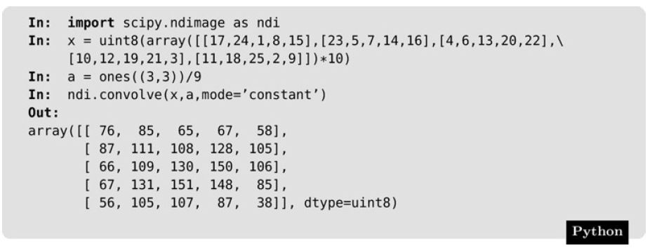
Filtering in Python
Python has no equivalent to fspecial and imfilter
Linear filtering can be performed by using convolve or correlate from the ndimage module of the scipy library, or generic_filter
x is representative of an image matrix
a is representative of a 3x3 averaging filter

Slide 28
Filtering in Python
Try it:
import skimage.io as io
import scipy.ndimage as ndi
import numpy as np
import matplotlib.pyplot as plt
c = io.imread('cameraman.png')
cf = ndi.convolve(c, np.ones((9, 9))/81)
fig, (ax1, ax2) = plt.subplots(ncols=2)
ax1.imshow(c, cmap='gray')
ax2.imshow(cf, cmap='gray')

Slide 29
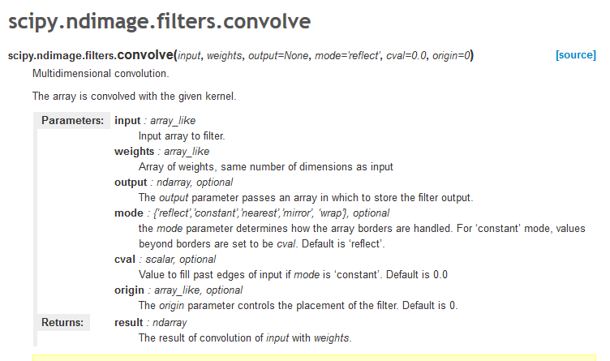
Filtering in Python

Slide 30
Frequencies
Frequency: A measure of the amount by which gray (color) values change with distance.
High Frequency: Large changes in gray values over small distances.
Edges
Noise
Low Frequency: Little change in the gray values.
Backgrounds
Skin textures

Slide 31
High Pass vs. Low Pass Filter
High Pass Filter: Passes over high frequency components, and reduces or eliminates low frequency components
Edge detection/enhancement
Example: Laplacian
Low Pass Filter: Passes over low frequency components, and reduces or eliminates high frequency components
Blurs edges, areas of high contrast
Example: Averaging filters, Gaussian

Slide 32
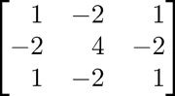
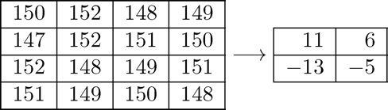
High Pass Filter
High pass filter:
Note: Sum of the coefficients in this high pass filter is zero. In a low frequency part of an image, where the gray values are similar, the result of using this filter is that the corresponding gray values in the new image will be close to zero.
Consider a 4 × 4 block of similar values pixels, and apply the above high pass filter to the central four:

Slide 33
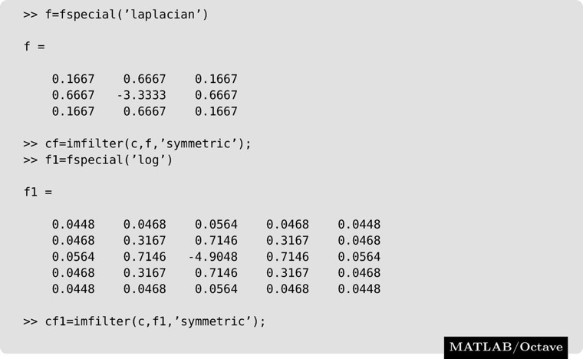
High Pass Filter

Slide 34
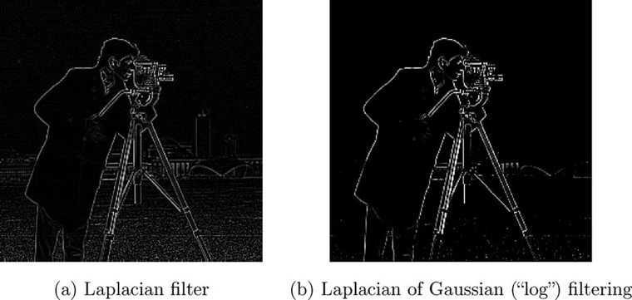
High Pass Filter
Note: MATLAB and Octave “clean up” the raw filtering.

Slide 35
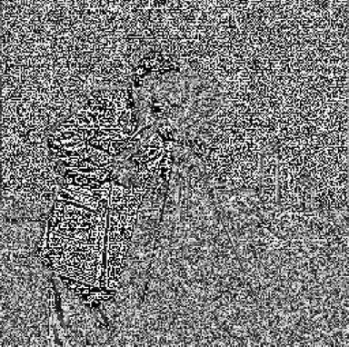
High Pass Filter
Raw filtering without any extra processing

Slide 36
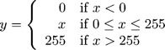
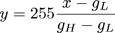
Values Outside Range 0-255
Applying a linear filter may produce values that lie outside 0-255. Solutions include:
Make negative values positive
Only fixes negative values
Only used in specific circumstances – only a few negative values and they are close to zero
Clip values
Not suitable if there are many gray values outside the 0–255 range
Scaling transformation
Lowest gray value gL, highest value is gH
Transform all values in the range gL − gH to the range 0–255 by the linear transformation:

Slide 37
Values Outside Range 0-255
Scaling transformation example
Assume lowest gray value gL = -56
Assume highest gray value gH = 528
Transform the following gray values:
-10, 6, 32, -56, 45, 350, 450, 528, 200

Slide 38
Values Outside Range 0-255
Scaling transformation example
Assume lowest gray value gL = -56
Assume highest gray value gH = 528
Transform the following gray values:
-10, 6, 32, -56, 45, 350, 450, 528, 200
Transformed Values:
20, 27, 38, 0, 44, 177, 221, 255, 112

Slide 39
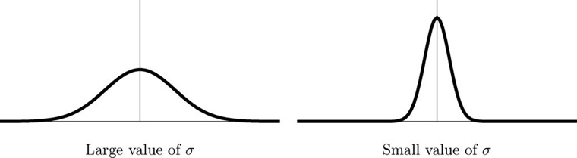
Gaussian Filters
Class of low pass filters based on the Gaussian Probability distribution function
where σ is the standard deviation: a large value of σ produces to a flatter curve, and a small value leads to a “pointier” curve.

Slide 40
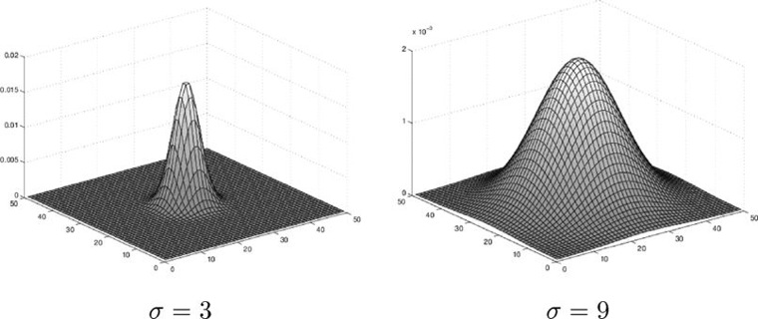
Gaussian Filters

Slide 41
Gaussian Filters
Important because:
1. Mathematically very “well behaved”; in particular the Fourier transform (see Chapter 7) of a Gaussian filter is another Gaussian.
2. Rotationally symmetric - very good starting points for some edge detection algorithms (see Chapter 9),
3. They are separable; in that a Gaussian filter may be applied by first applying a one-dimension Gaussian in the x direction, followed by another in the y direction. This can lead to very fast implementations.
4. The convolution (filter rotated by 180◦) of two Gaussians is another Gaussian.

Slide 42
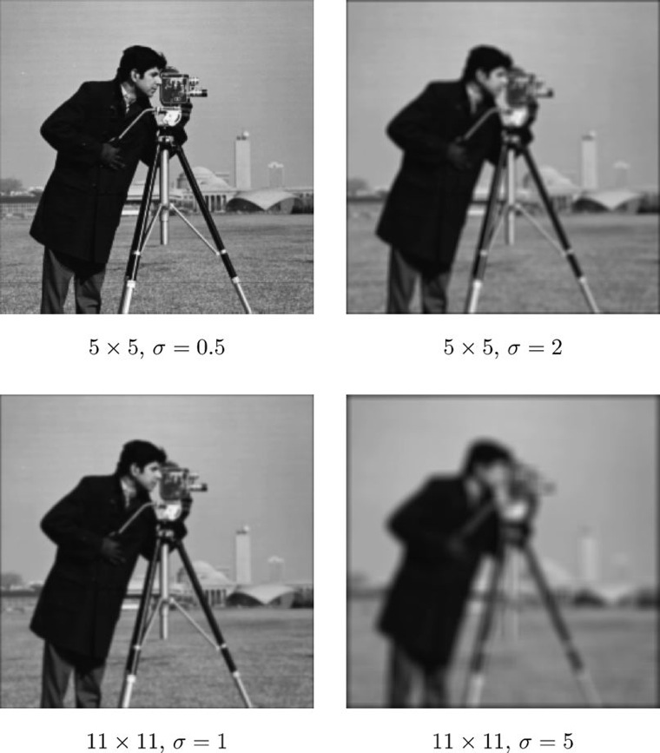
Gaussian Filters

Slide 43
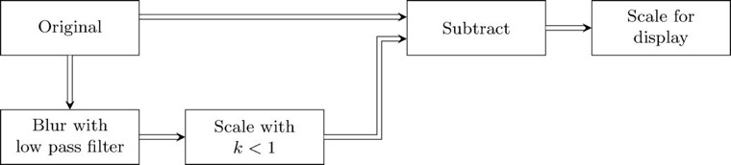
Edge Sharpening
Spatial filtering can be used to make edges in an image slightly sharper and crisper
Generally results in an image more pleasing to the human eye
“edge enhancement,” “edge crispening,” or “unsharp masking”

Slide 44
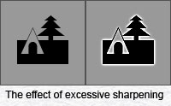
Unsharp??? To sharpen???
The name has its origins, as do many things photographic, in the conventional darkroom.
Creating a print the old-fashioned way involves exposing photosensitive paper by projecting onto it a negative of the desired image. In order to accentuate edges in a print and thus make it look sharper, the darkroom operator made something called an unsharp mask.
The technique consists of creating a weak, slightly out of focus positive transparency of the original negative. Rather than exposing the negative on photographic paper, it is instead exposed on another sheet of film. Thus, this new version will be a positive image. Since we recorded it slightly out of focus, if we sandwich it with the original piece of film, all the edges in the composite image will have slight halos in the exact opposite color of whatever is on the other side of each edge.
http://www.earthboundlight.com/phototips/unsharp-mask.html

Slide 45
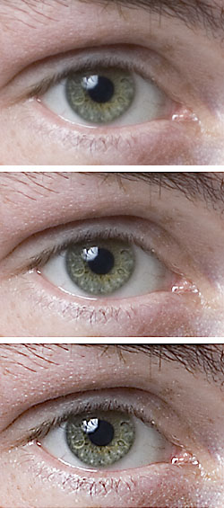
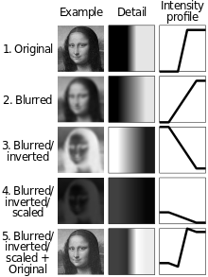

Simplified principle
https://en.wikipedia.org/wiki/Unsharp_masking

Slide 46
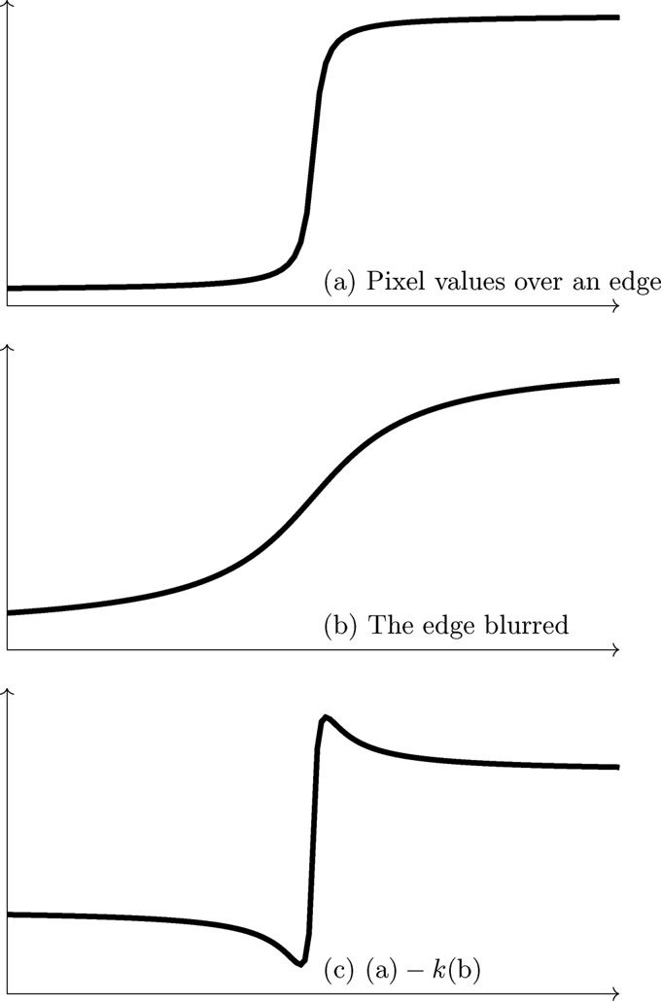
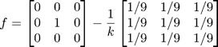
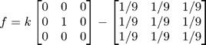
We are in effect subtracting a blur from a scaled version of the original; the scaling factor may also be split between the identity and blurring filters.
Examples using averaging filter to blur:
or
where k is a constant chosen to provide the best result.

Slide 47
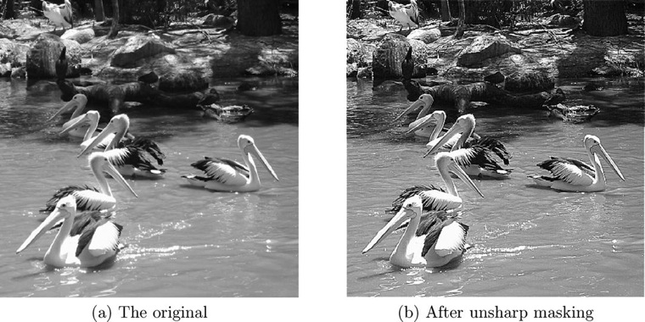
Unsharp Mask

Slide 48
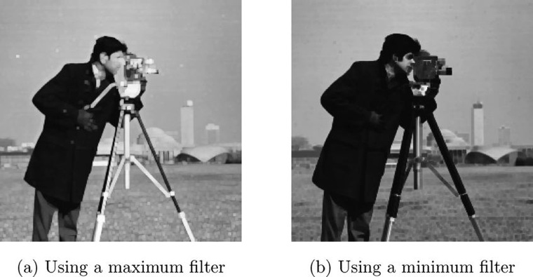
Non-linear filters
Non-linear filter: A filter that applies a non-linear function to the grayscale values in the mask.
Example: Max or min filter, which has as its output the max or min value under the mask

Slide 49
Regions of Interest (ROI)
Two ways to define an ROI:
List the coordinates of a polygonal region
Define interactively with the mouse

Slide 50
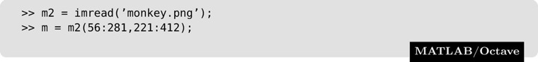
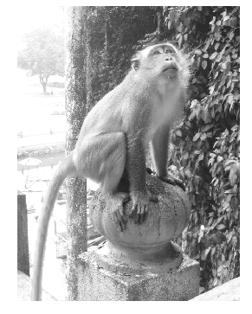
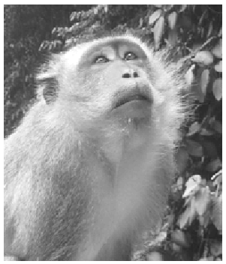
Regions of Interest (ROI)
imshow(m2)
imshow(m)

Slide 51
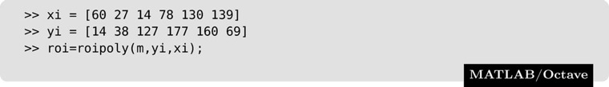
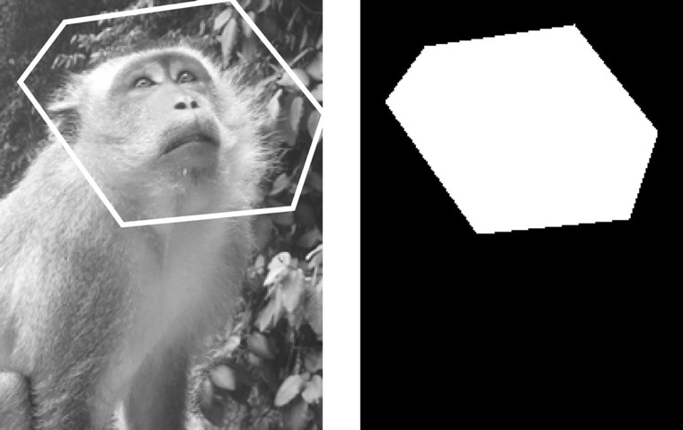
Regions of Interest (ROI)
warning: the 'roipoly' function belongs to the image package from Octave Forge
but has not yet been implemented.
Please read `http://www.octave.org/missing.html' to learn how you can
contribute missing functionality.
c
b
a
d
f
e
Hexagon Points:
a(60, 14) b(27, 38), c(14, 127)
d(78, 177) e(130, 160) f(139, 69)

Slide 52
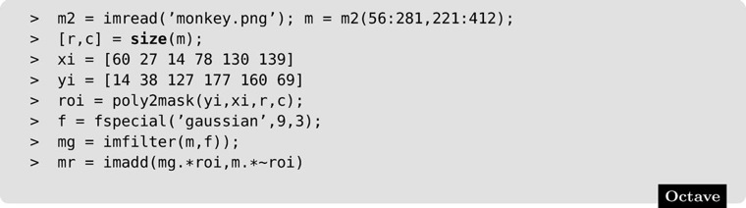
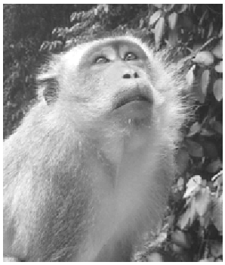
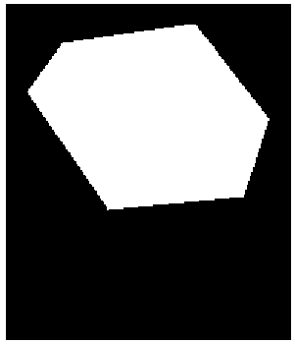
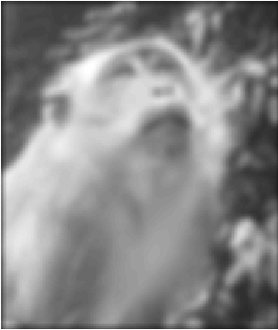
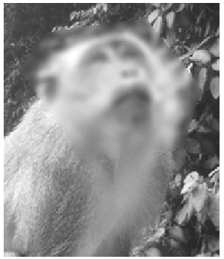
Regions of Interest (ROI)
% Typo in book, remove extra ')'
imshow(m)
imshow(roi)
imshow(mg)
imshow(mr)

